Slide 1
Gradient Descent (Variants, Problems and Solutions)

Slide 2
What is Gradient Descent?
It is a first-order iterative optimization algorithm for finding a local minimum of a differentiable function.
The idea is to take repeated steps in the opposite direction of the gradient of the function at the current point.
With respect to Neural Network supervised learning, the function to be minimized is the Error function or Loss function.
It is used in conjunction with Error Back Propagation (EBP) algorithm to adjust the weight matrix also called network parameters.
The fundamental steps are:
Initialize all the weights with random values
Forward pass
Backward pass

Slide 3
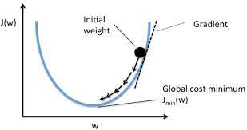
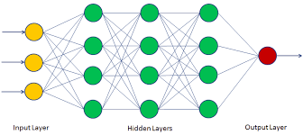
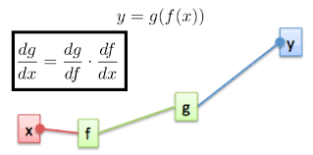
Gradient Descent (Continued….)
The Gradient Descent comes into the picture during the backward pass.

Slide 4
Gradient Descent (Continued….)
Variants of the Gradient Descent
Batch Gradient Descent
Also called Vanilla Gradient Descent
Calculates error for each training sample but the weights are updated only at the end of epoch.
Advantage: guaranteed to converge to the global minimum if the loss function is convex and to a local minimum if the loss function is not convex.
Disadvantage: slow to go over all examples especially for large datasets.
Stochastic Gradient Descent (SGD)
Also called Online Gradient Descent
Calculates error for each training sample and the weights are updated immediately after observing each sample.
Advantage: improves generalization error
Disadvantage: learning process becomes noisy as weights are updated for each sample.

Slide 5
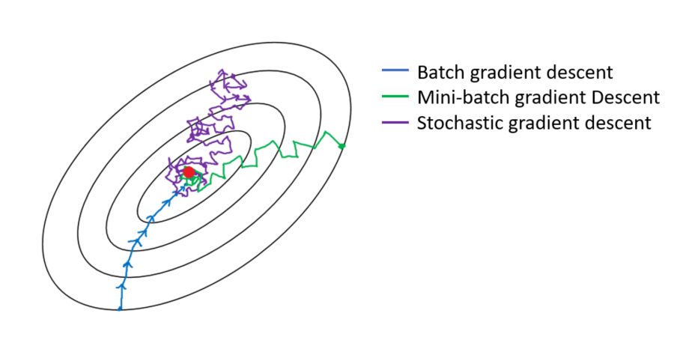
Gradient Descent (Continued….)
Mini-Batch Gradient Descent
Combination of Batch Gradient Descent and Stochastic Gradient Descent
The training set is divided into multiple batches and the weights are updated at the end of observing each batch.
The batch size varies between 50 to 250 samples depending upon the size of the entire training set.
Advantage: faster than Batch Gradient
Disadvantage: may not converge at all

Slide 6
Vanishing Gradient Problem
Chain rule of differentiation causes the gradient of the loss function to decrease exponentially.
For deep network with large number of hidden layers, the gradient of the loss function approaches zero making the weights near the input layers impossible to be learned or updated.
The problem gets aggravated for activation functions such as Sigmoid which maps large input (absolute value) to a very small output value between 0 to 1

Slide 7
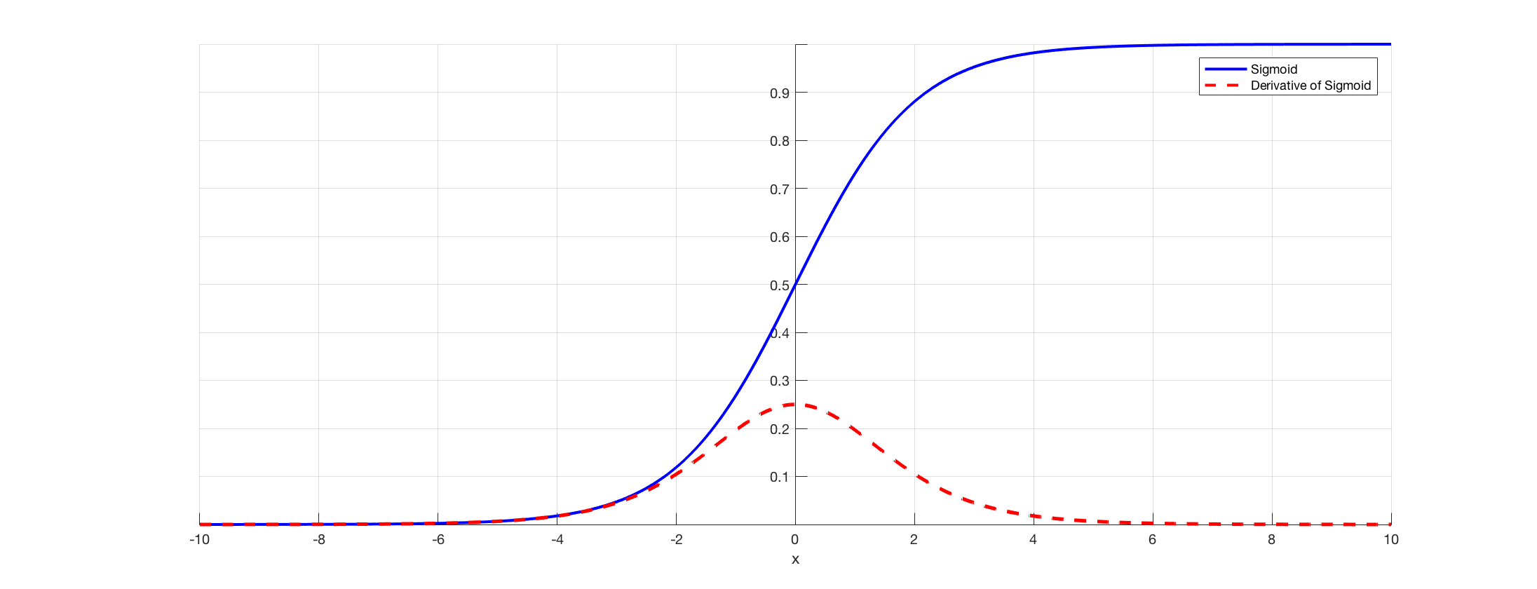
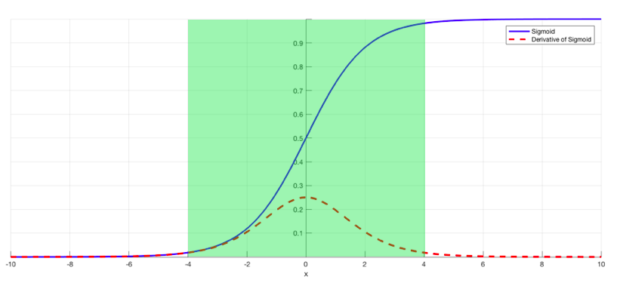
Vanishing Gradient Problem….
example
Solutions:
Batch normalization

Slide 8
Vanishing Gradient Problem….
Use of activation functions such as ReLU which doesn’t cause a very small derivative
Residual Networks (ResNets)
ResNets refer to neural networks where skip connections or residual connections are part of the network architecture.
These skip connections allow gradient information to pass through the layers, by creating "highways" of information
They avoid the problem rather than solving it

Slide 9
Challenges to GD
Selection of appropriate learning rate
Too small – very slow to convergence
Too large – fluctuations around minima
Learning rate schedules
Schedule must be predefined
Doesn’t adapt to the characteristics of the dataset
Same learning rate for all the parameters
Not suitable for features with different frequencies
Larger updates needed for rarely occurring features
Saddle points
Points where one dimension slopes up and another dimension slopes down
GD gets trapped

Slide 10
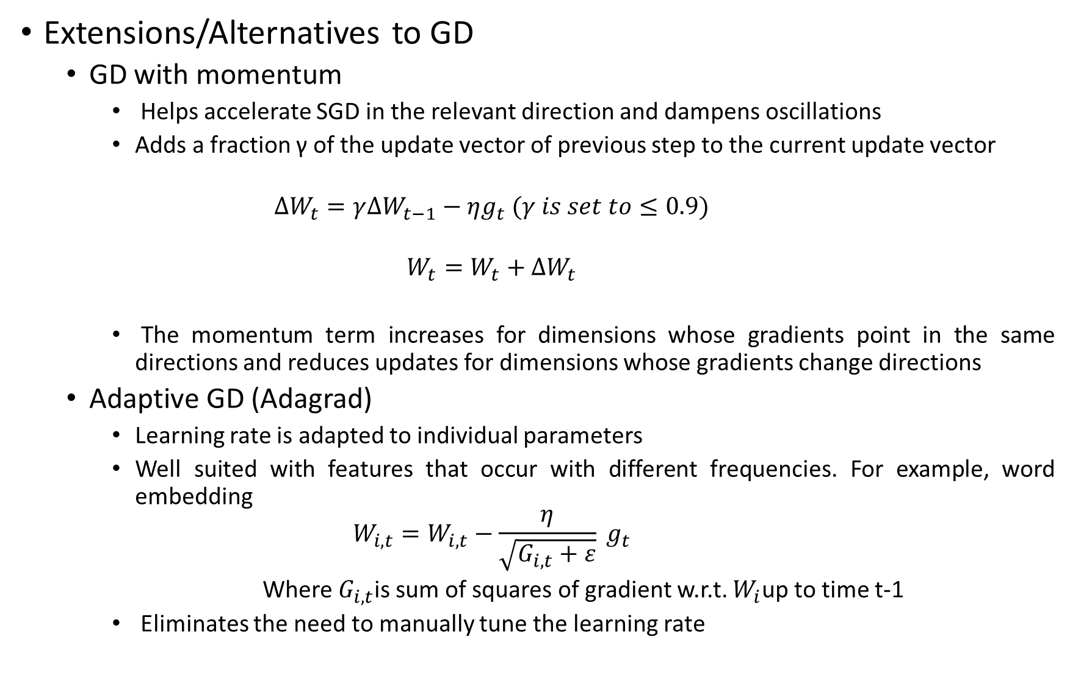
Extensions/Alternatives to GD
GD with momentum
Helps accelerate SGD in the relevant direction and dampens oscillations
Adds a fraction γ of the update vector of previous step to the current update vector
$$∆W_{t}=γ{∆W}_{t−1}−ηg_{t} (γ is set to≤0.9)$$
$$W_{t}=W_{t}+∆W_{t}$$
The momentum term increases for dimensions whose gradients point in the same directions and reduces updates for dimensions whose gradients change directions
Adaptive GD (Adagrad)
Learning rate is adapted to individual parameters
Well suited with features that occur with different frequencies. For example, word embedding
$$W_{i,t}=W_{i,t}−\frac{η}{\sqrt{G_{i,t}+ε}} g_{t}$$
Where $G_{i,t}$is sum of squares of gradient w.r.t. $W_{i}$up to time t-1
Eliminates the need to manually tune the learning rate

Slide 11
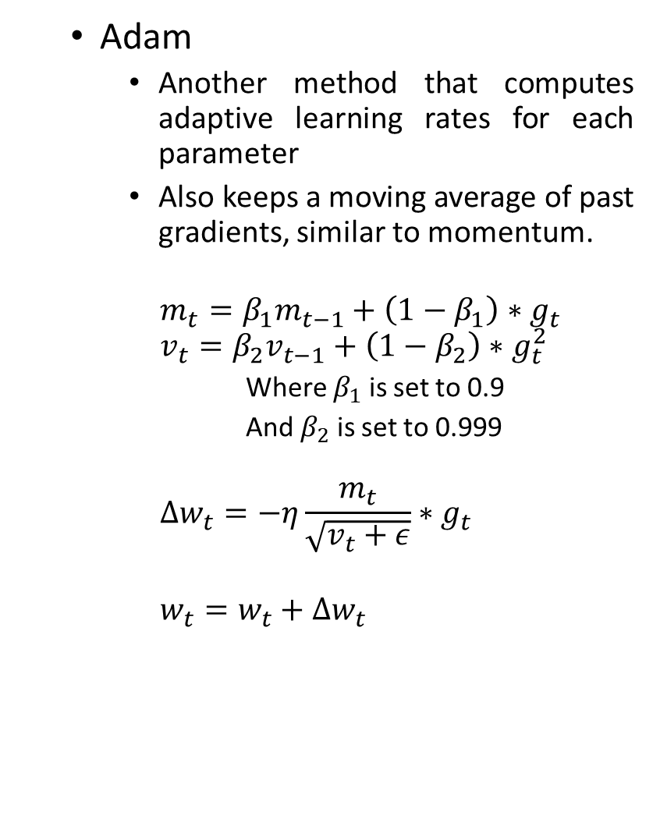
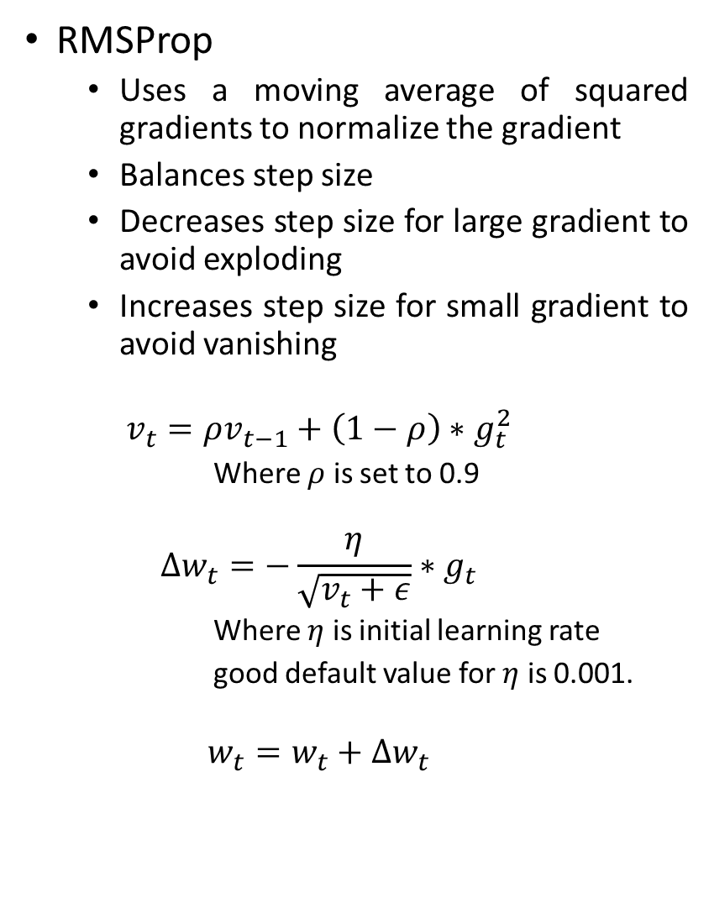
RMSProp
Uses a moving average of squared gradients to normalize the gradient
Balances step size
Decreases step size for large gradient to avoid exploding
Increases step size for small gradient to avoid vanishing
$$v_{t}=ρv_{t−1}+\left(1−ρ\right)∗g_{t}^{2}$$
Where $ρ$ is set to 0.9
$$∆w_{t}=−\frac{η}{\sqrt{v_{t}+ε}}∗g_{t}$$
Where $η$ is initial learning rate
good default value for $η$ is 0.001.
$$w_{t}=w_{t}+Δw_{t}$$
Adam
Another method that computes adaptive learning rates for each parameter
Also keeps a moving average of past gradients, similar to momentum.
$$m_{t}=β_{1}m_{t−1}+\left(1−β_{1}\right)∗g_{t}$$
$$v_{t}=β_{2}v_{t−1}+\left(1−β_{2}\right)∗g_{t}^{2}$$
Where $β_{1}$ is set to 0.9
And $β_{2}$ is set to 0.999
$$Δw_{t}=−η\frac{m_{t}}{\sqrt{v_{t}+ε}}∗g_{t}$$
$$w_{t}=w_{t}+Δw_{t}$$

Slide 12
Thank You

